Slide 1
Superstore Data Visualization
By Pabba Abhishek
Presented on 09/06/21

Slide 2
Situation presented
As a business manager of a superstore retail chain, I’m analyzing the data about sales and profits of the company. The following is the data gathered to analyse.
Ship Mode | Segment | Country | City | State | Postal Code | Region | Category | Sub-Category | Sales | Quantity | Discount | Profit
Standard Class | Consumer | United States | Seattle | Washington | 98115 | West | Furniture | Tables | 1747.25 | 5 | 0 | 629.01
Standard Class | Corporate | United States | Seattle | Washington | 98103 | West | Furniture | Tables | 3393.68 | 8 | 0 | 610.8624
First Class | Home Office | United States | Harrisonburg | Virginia | 22801 | South | Furniture | Tables | 2244.48 | 7 | 0 | 493.7856
Second Class | Home Office | United States | Seattle | Washington | 98105 | West | Furniture | Tables | 1913.4 | 9 | 0 | 401.814
Second Class | Home Office | United States | Seattle | Washington | 98115 | West | Furniture | Tables | 2348.82 | 9 | 0 | 399.2994
. . . | . . . | . . . | . . . | . . . | . . . | . . . | . . . | . . . | . . . | . . . | . . . | . . .
Standard Class | Consumer | United States | Jackson | Mississippi | 39212 | South | Furniture | Tables | 2430.08 | 8 | 0 | 388.8128

Slide 3
Goal of the project
Finding the best and least performing areas.
Visually presenting the findings and letting the shareholders see them.
Recommend solutions to increase profits in those areas.
Forecast the growth with the following suggestions.

Slide 4
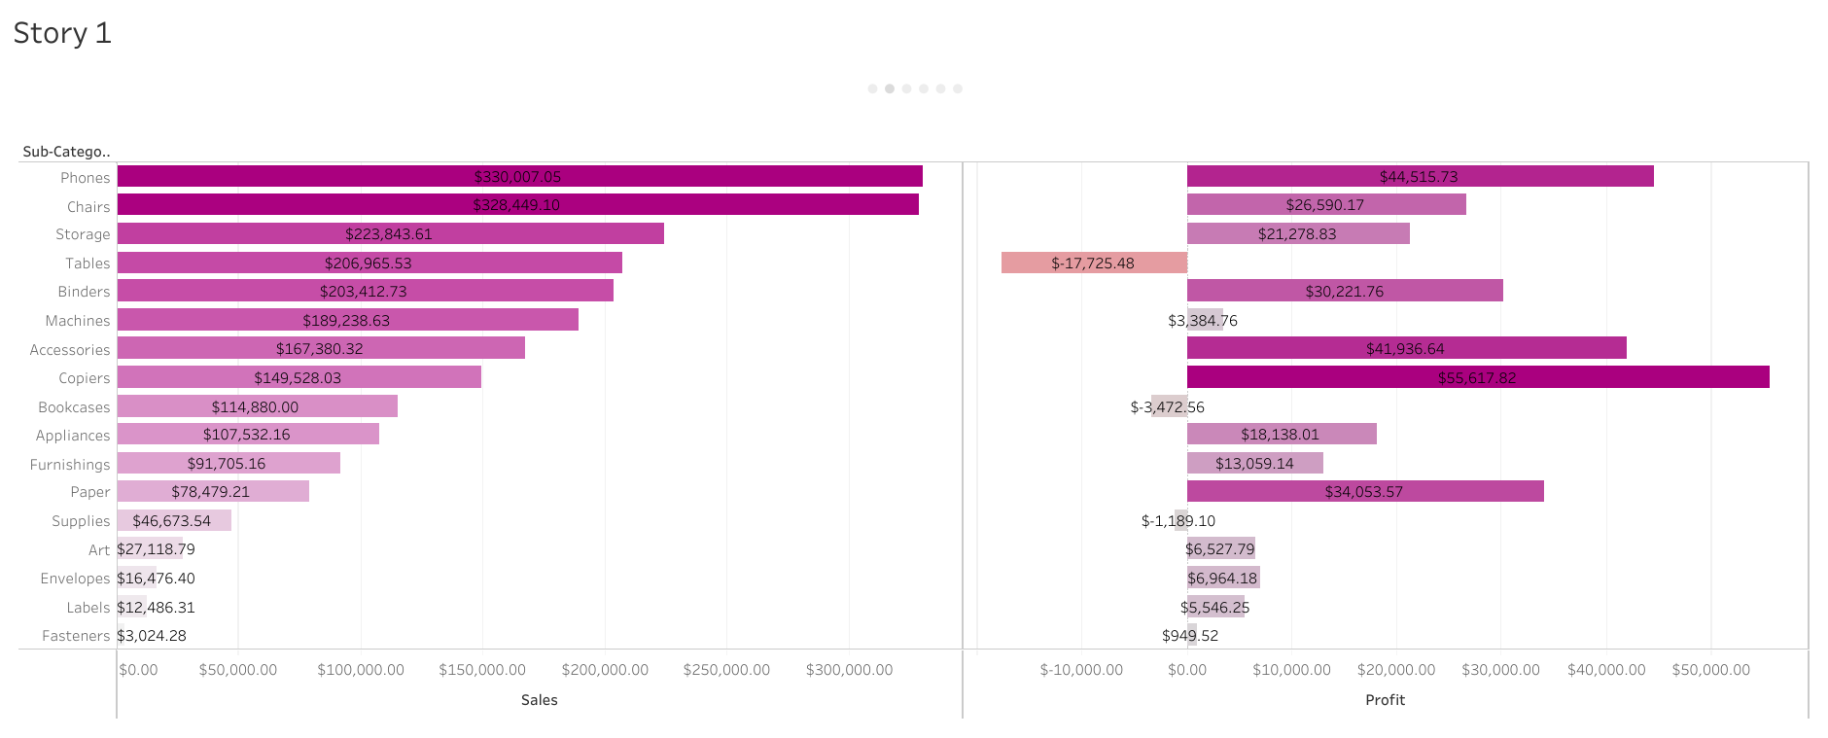
Profit and sales for each sub-category

Slide 5
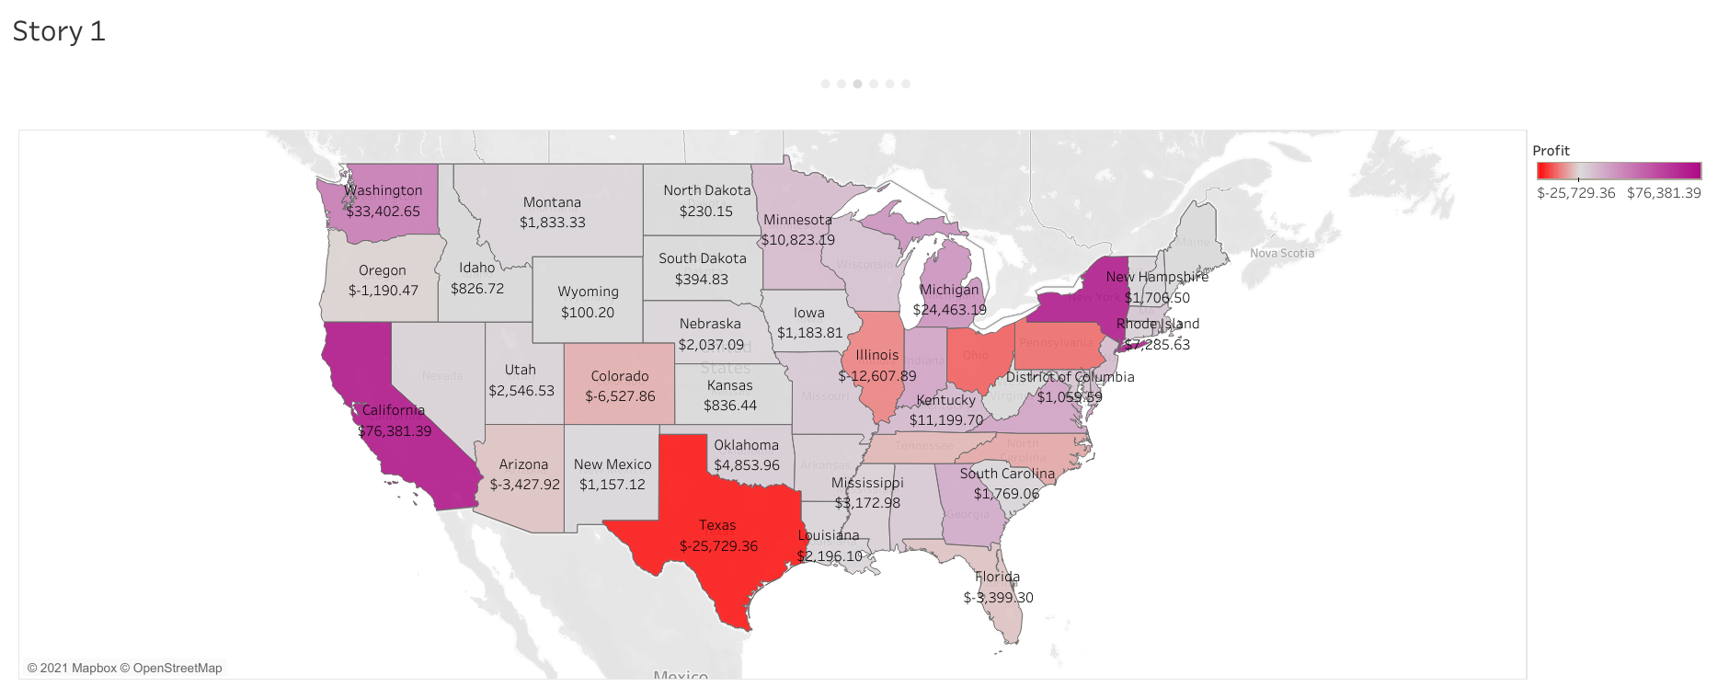
State wise Profit

Slide 6
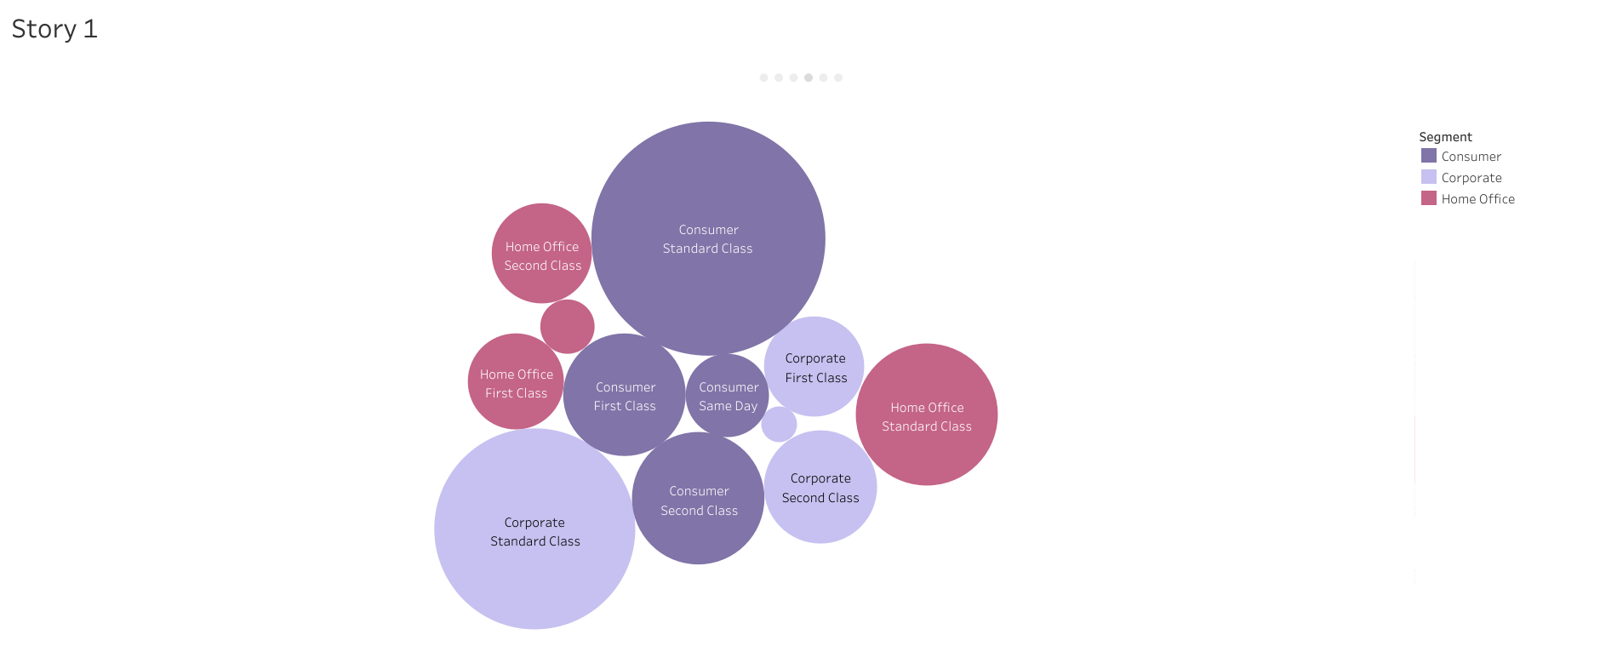
Segment and ship mode relation with sales
Most sales

Slide 7
Things to be noted
Most sold Sub-category is Phones
Most profitable Sub-category:
Copiers
Phones
Accessories
Best performing states:
California,
New York &
Washington
Most sales from Standard and Consumer class.
Least performing Sub-categories:
Tables
Supplies
Bookcases
Least performing states:
Texas,
Illinois,
Pennsylvania & Ohio

Slide 8
Things should be done further
1
2
3
4
Best performing and least performing state outlets to be contacted.
Further information regarding shipment mode and segment mode is to be gathered.
Relation between quantity, profits, discount and sales need to be further clarified.
Time period of the sales should be gathered to understand the periodic patterns in sales if any present.

Slide 9
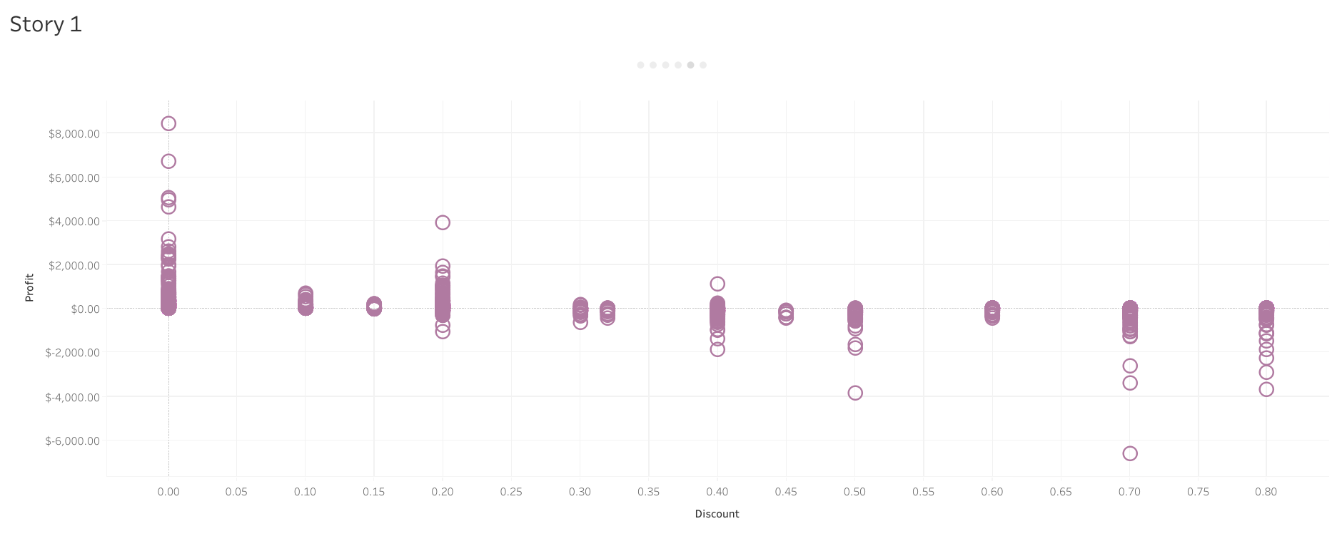
Higher the discount higher the losses

Slide 10
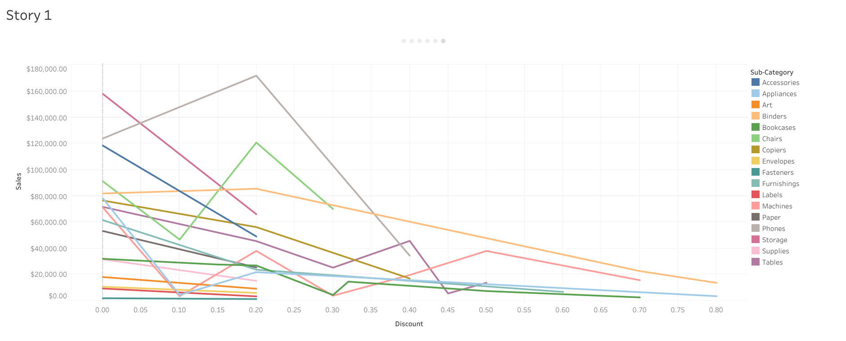
Sales are independent of discount

Slide 11
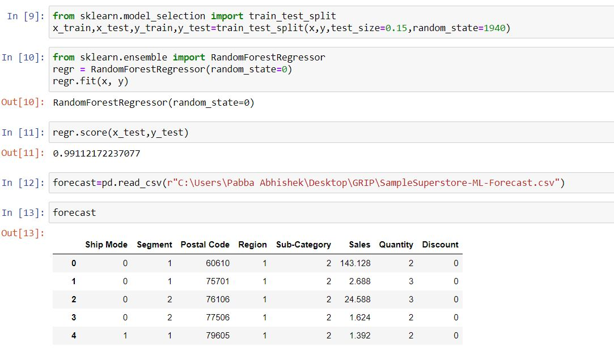
Using ML to predict profits for 0 discount
As noticed earlier, huge discounts are leading to huge losses and discounts are nowhere promoting the sales.
Using a machine learning model, the profits are forecasted if for the same sales there was a zero discount

Slide 12
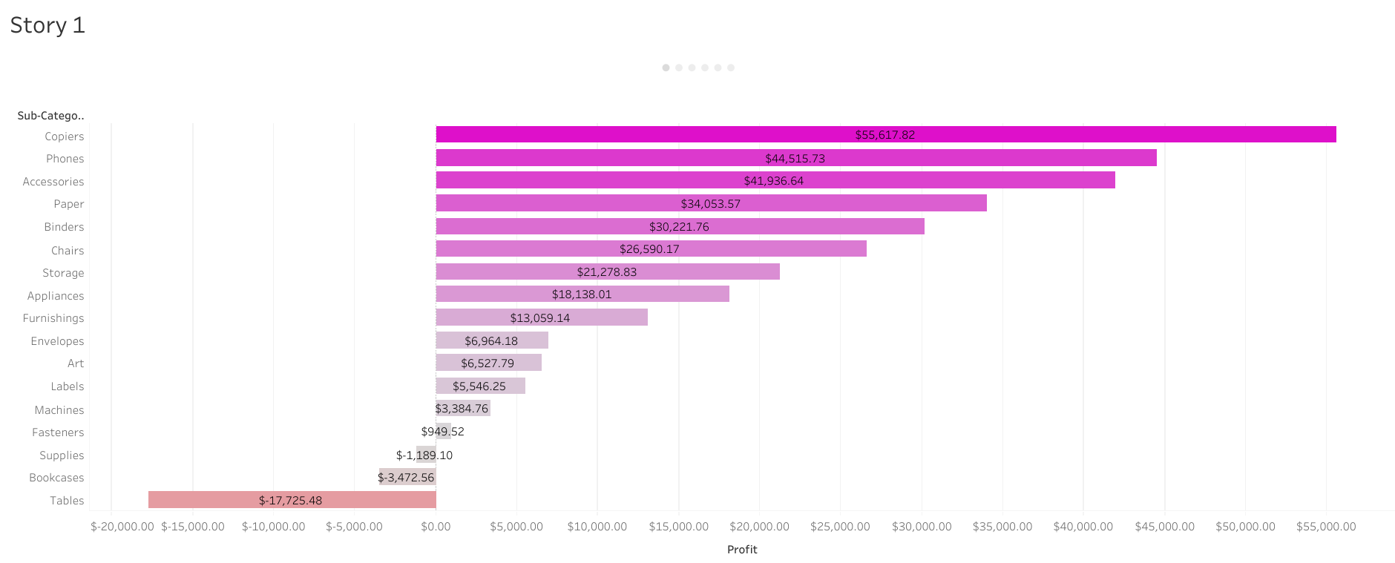
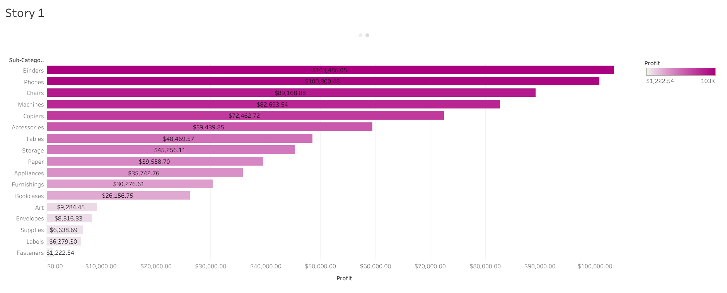
Original profits vs Forecasted profits at 0 discount
Original profits
Forecasted profits

Slide 13
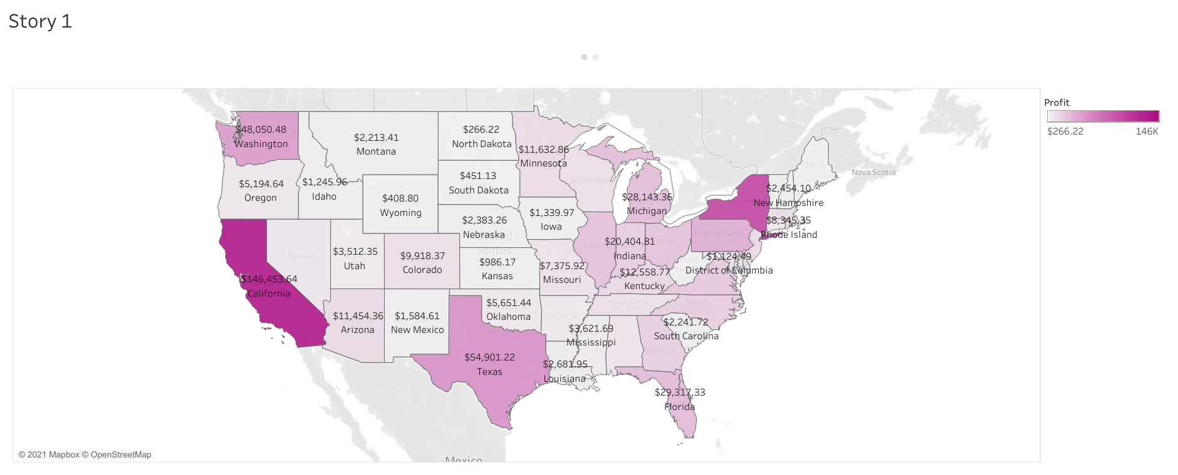
State wise improvement in profits
Original profits
Forecasted profits

Slide 14
Suggestions to increase profits
Reducing discounts for all products can drastically improve the profits.
Knowledge from best performing states should be used for least performing states.
Promoting low sales sub-categories like labels and art can benefit.
Upgrading the same day ship mode and marketing more on corporate and home office segment can bring profit in longer run

